Slide 1
Gymnastics Festival
This is an inclusive festival suitable for gymnasts who do not compete and would like to have a go in a pressure free environment.

Slide 2
Scoring
Every gymnast will try 5 skills and will be given a score out of 5 for each skill. These scores will be added to find their grand total. Depending on scores you can earn bronze, silver or a gold award. Scorecard example.

Slide 3
Scoring
Two ways Digital or paper
Paper = All gymnasts take their scorecard around with them and hand to the judge and teachers/students tally own score at the end.
Digital= Judges fill sheet via phone/laptop
Think it would be nice for all gymnasts to bring own decorated number
Any gymnasts scoring Distinction should be entered into British Schools the following year (British schools info)

Slide 4
Scoring example.
95+ points= GREEN-Distinction
75+= Gold
50+ = Silver
25+ = Bronze
Each skill is rated out of 5.
1= Can just achieve the move
3= Comfortable
5= Successfully do the move

Slide 5
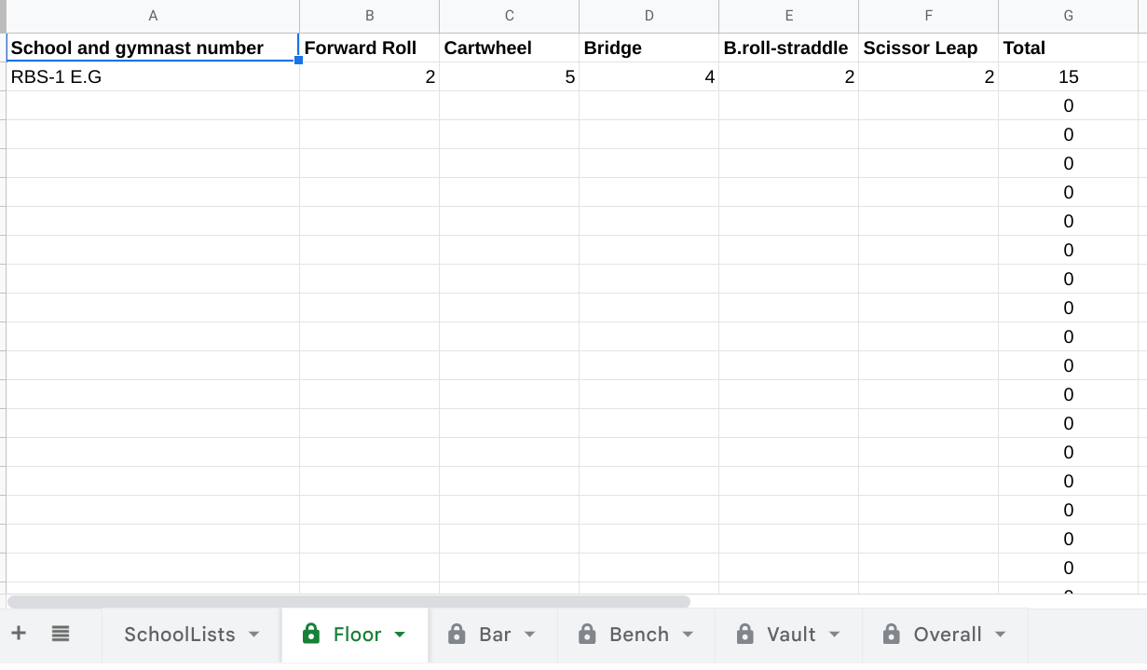
Judges
Floor
Vault
Beam
Bar will be judged.
Range and Conditioning will be a practice station.
Judges
Will score each move out of 5.
Judges will update the scores into a data sheet on a mobile device. (names and schools will be automated)
Scores will be automatically calculated.

Slide 6
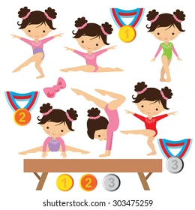
Common Deductions
Not Pointing Toes Bent Legs Poor Posture Lack of height Wobbles/Falls Not holding the move for 3 seconds

Slide 7
Set up
Each school will go round all 6 stations.
The judges will explain the moves to the students and discuss with the teachers what judges are looking for (CPD). Local gym leaders will demonstrate the skills at each area.
Floor- Line of Mats
Bar- Wall Bars/Free standing bars
Floor Beam/Bench (optional)
Vault- Springboard and block
Range-Mats
Practice area-Mats

Slide 8
Set up
Floor
Floor
Bars
Bars
Mat
Judges desk outside
Waiting pen in centre.
30cm block
Practice area
S.Board
Range and conditioning
Bench
Bench

Slide 9
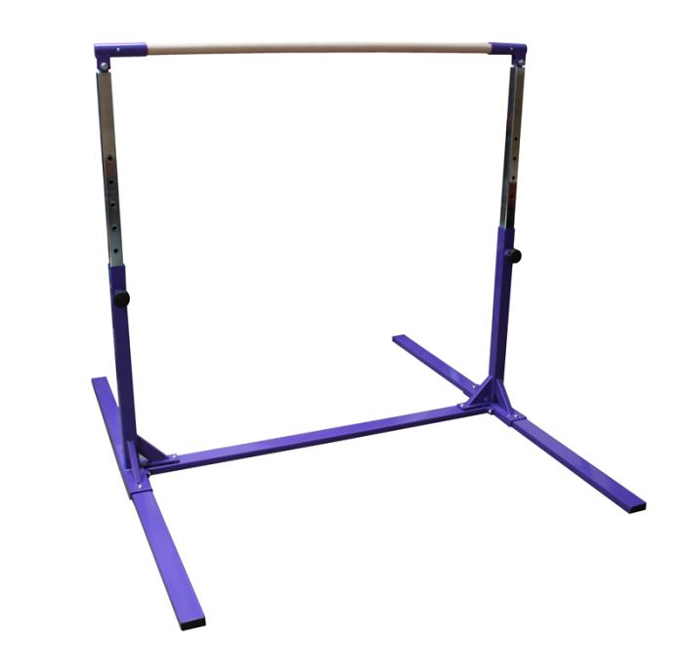
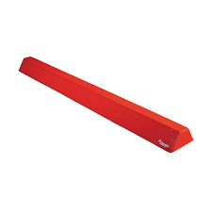
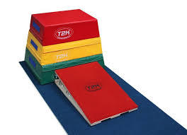
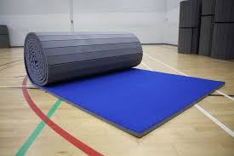
Equipment

Slide 10
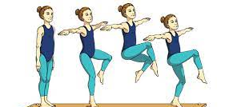
Floor
Forward roll
Cartwheel
Bridge
Backwards Roll to straddle
Cat leap scissor Kick

Slide 11
Judge-Floor
Moves | 1 point | 3 points | 5 points
Forward roll | Head close to floor | Tucked to feet | Straight legs/arms
Cartwheel | Correct pattern | Show star | Full splits
Bridge | Bent legs and gaps | No gaps | Locked legs chest forward
Back Roll Straddle | Crouching | Bent legs | Straight arms/Legs
Cat/scissors leap | Off the ground | Smooth link | Legs locked and presented

Slide 12
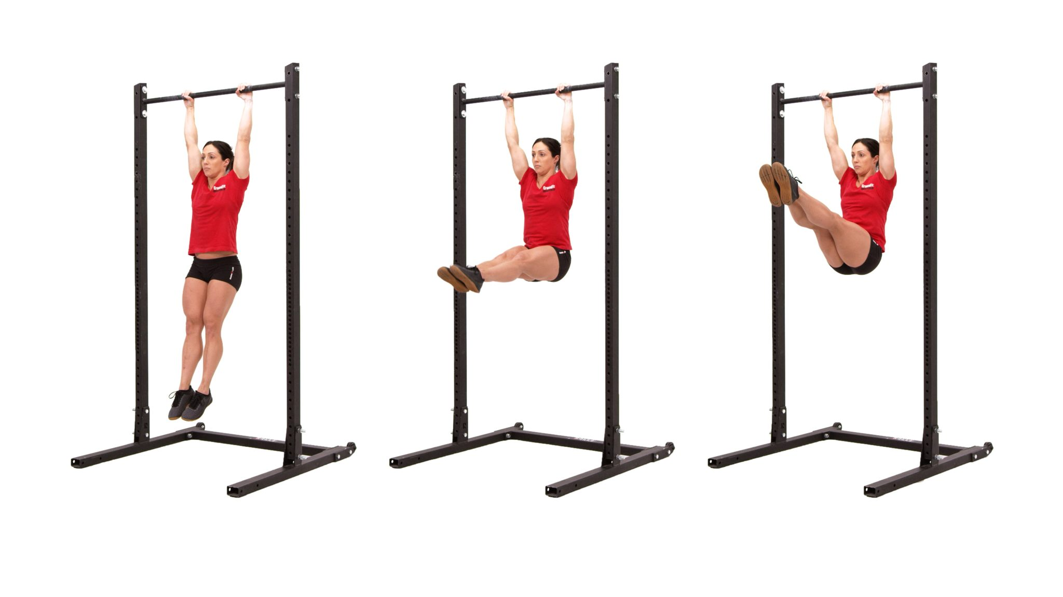
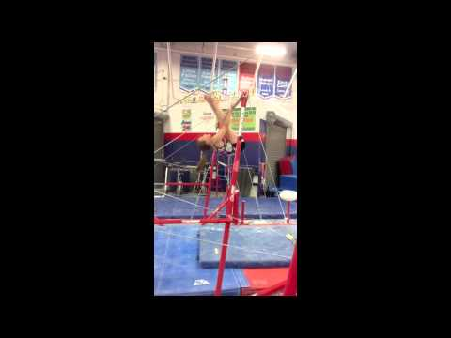
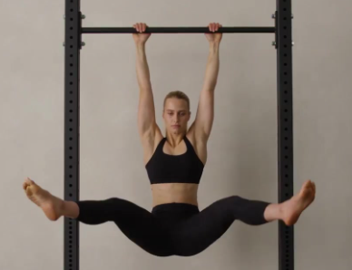
Bar
One arm hang
Pike hold
Skin the cat
3
5
1
Straddle hold
Pull up

Slide 13
Judge-Bar
Moves | 1 point | 3 points | 5 points
Pull/Chin Ups | Bend arms slightly | Face near bar | Chest by bar + Held
Pike hang | Low & Bent | Flat | Above Hips
Straddle hang | Low & Bent | Flat | Above Hips
Skin the cat | Legs touch bar | Goes through legs and back | Straight legs showing pike
1 arm hang | Moment hanging | Hanging no form | Stable hanging straight (3 secs)

Slide 14
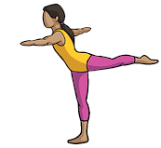
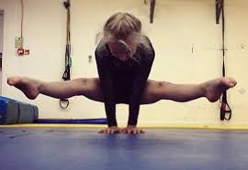
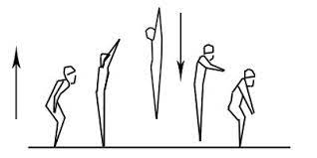
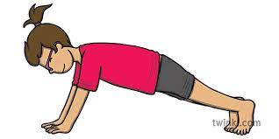
Balance BEAM/BENCH
Straddle lift
Broad jump
Front support- Stretched
Arabesque
One leg raise

Slide 15
Judge-Balance
Moves | 1 point | 3 points | 5 points
Straddle lift | Lifts up | Hold ups | Legs above Hips
Broad jump | Lack of height | Bent legs in flight | Straight and high
Front support stretch | Bum up and high | Flat body, arms straight | Full stretch and still
Arabesque | One leg | Leg straight | Chest up
One leg raise | Bent and low | Straight | Above hip

Slide 16
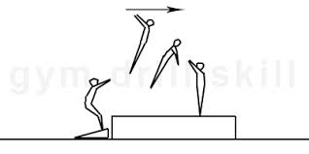
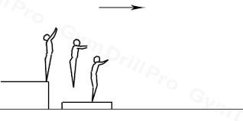
Vault
Straight jump onto block Straight jump off

Slide 17
Judge-Vault
Moves | 1 point | 3 points | 5 points
Run up | Slow | Flat Feet | Fast Ball of foot
Hurdle Step | 1 to 1 | 1 to 2 bent legs | Legs lock
Straight jump On | Bent legs apart | Feet together | Squeezed tight
SJ off -Block | Jump down | Height | Straight through out
Landing | Hop/bounce | Step | Straight back

Slide 18
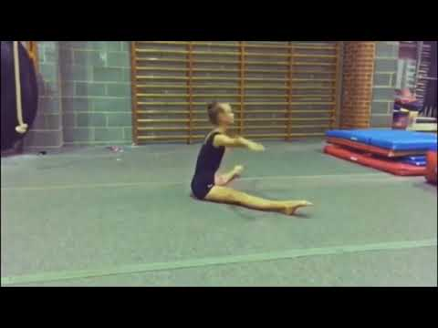
Practice Station-Range + Conditioning
V- Sits x 4
Back Support
Japana
Pike Fold
Splits
Front Support
Arch
Straight Jump

Slide 19
Judge-Range
Moves | 1 point | 3 points | 5 points
Back Support | Low to ground | Buckled arms/legs | Hips up
Japana | Legs straight | +45 deg | Tummy on ground
Splits | Attempted | Hips misaligned | Flat no arms support
Front Support | Press up shape | Back flat | Flat body rounded shoulders
Arch | Arms feet in the air | Arms straight legs straight | Chest up

